Slide 1
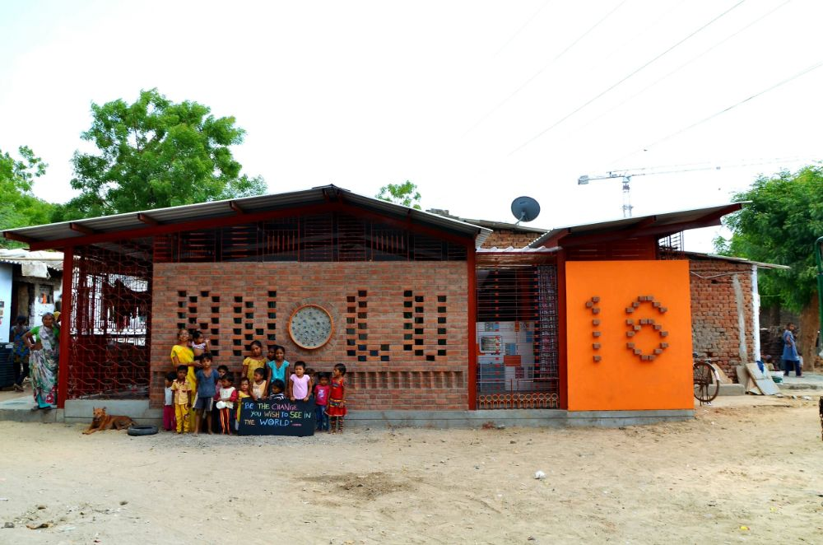
Swasth-a-thon: Innovating Child Nutrition in India
Transforming child health outcomes through integrated, data-driven solutions.
Team: Arogya
Sanat Karkhanis
Sanjeta Singh Sarvesh Pingale Suraj Rout Abhishek Shelar

Slide 2

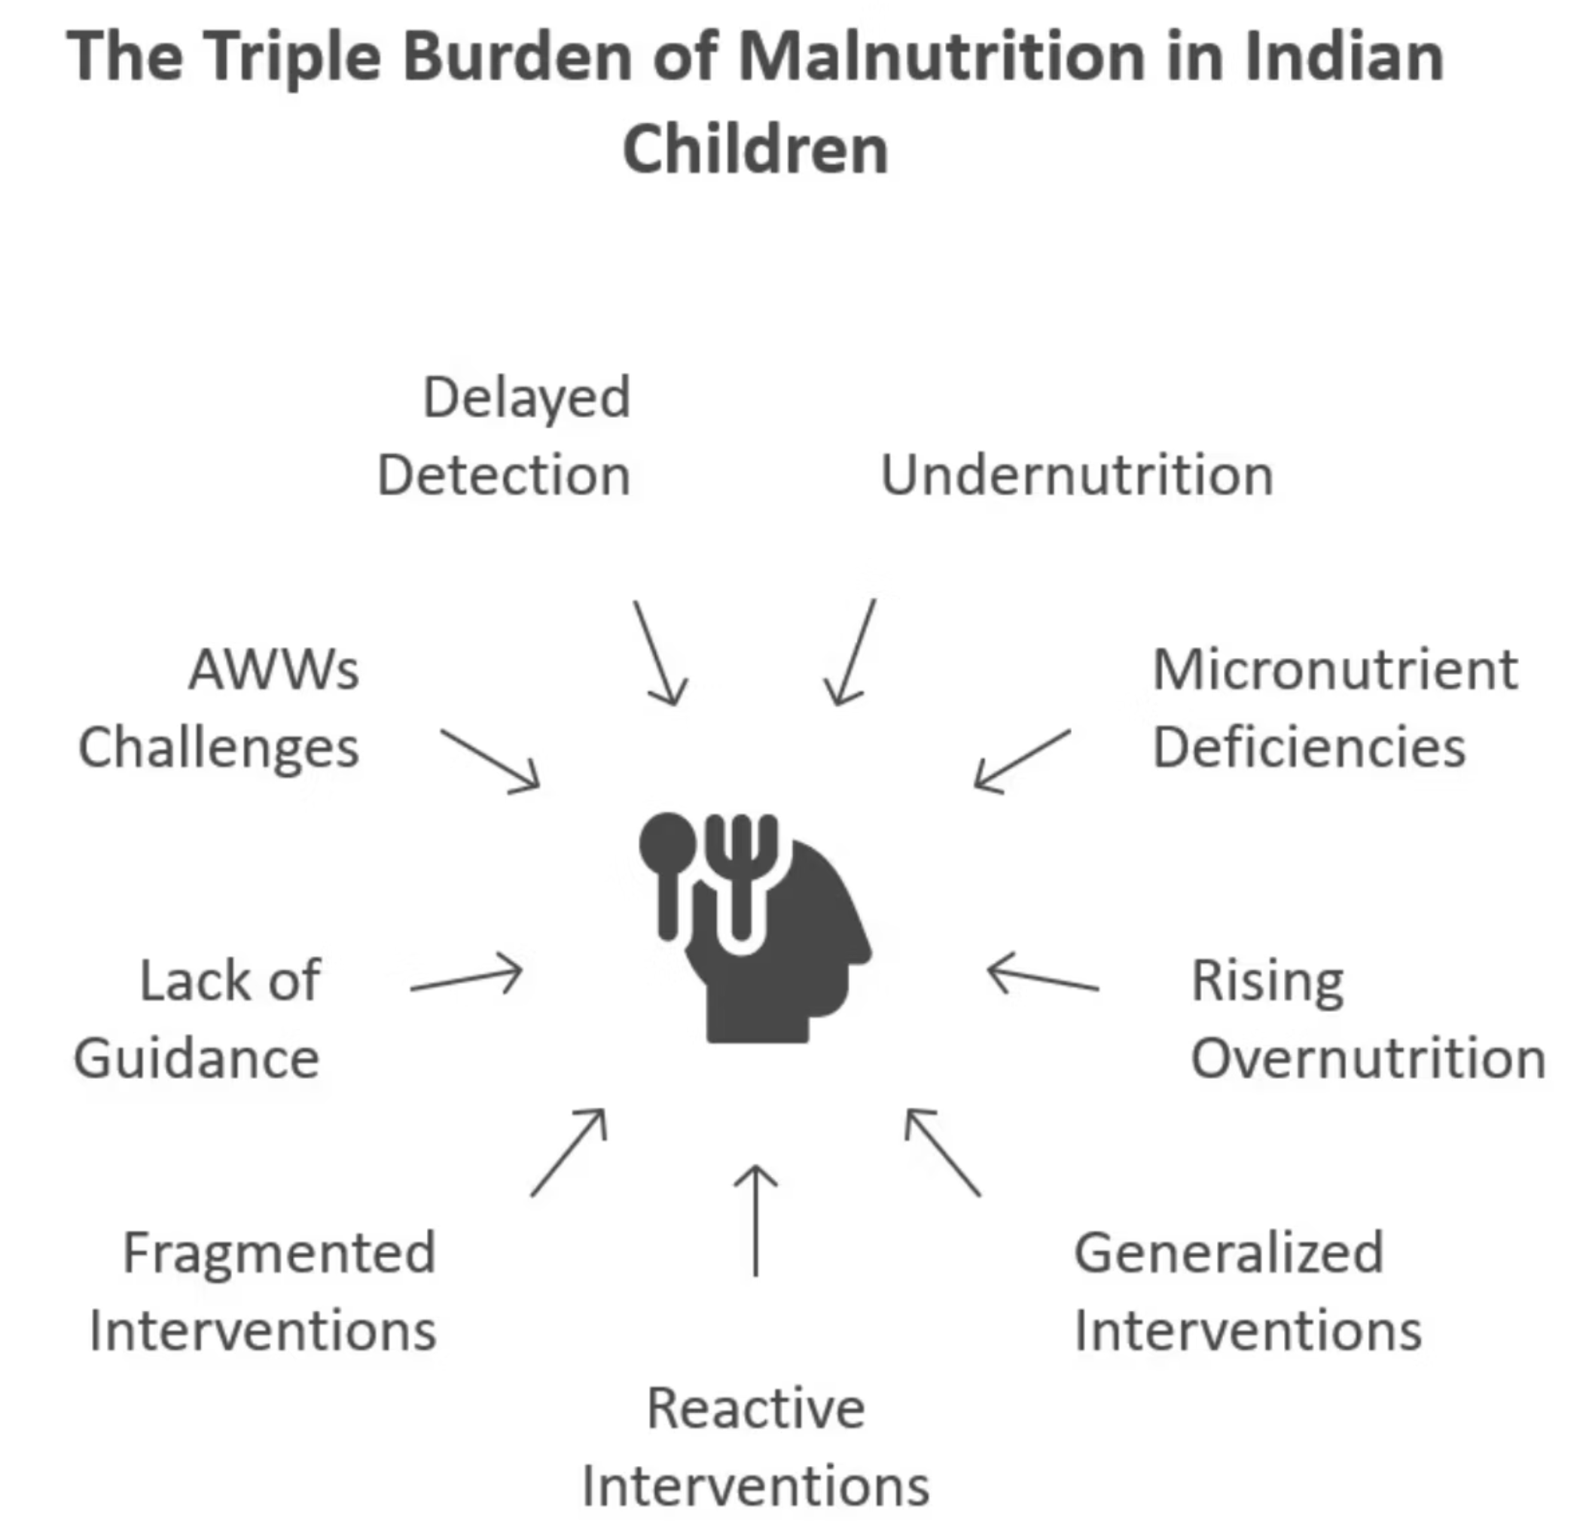
The Triple Burden: A Critical Challenge for India's Children
Undernutrition
Micronutrient Deficiencies
Manifesting as stunting (low height-for-age), wasting (low weight-for-height), and underweight (low weight-for-age).
Such as iron, Vitamin A, and zinc deficiencies, crucial for growth and immunity.
Rising Overnutrition
Increasing rates of overweight and obesity, leading to long-term health complications.
Current interventions are often generalized, reactive, and siloed, struggling to effectively address these co-existing challenges within the same communities and even within the same households.

Slide 3

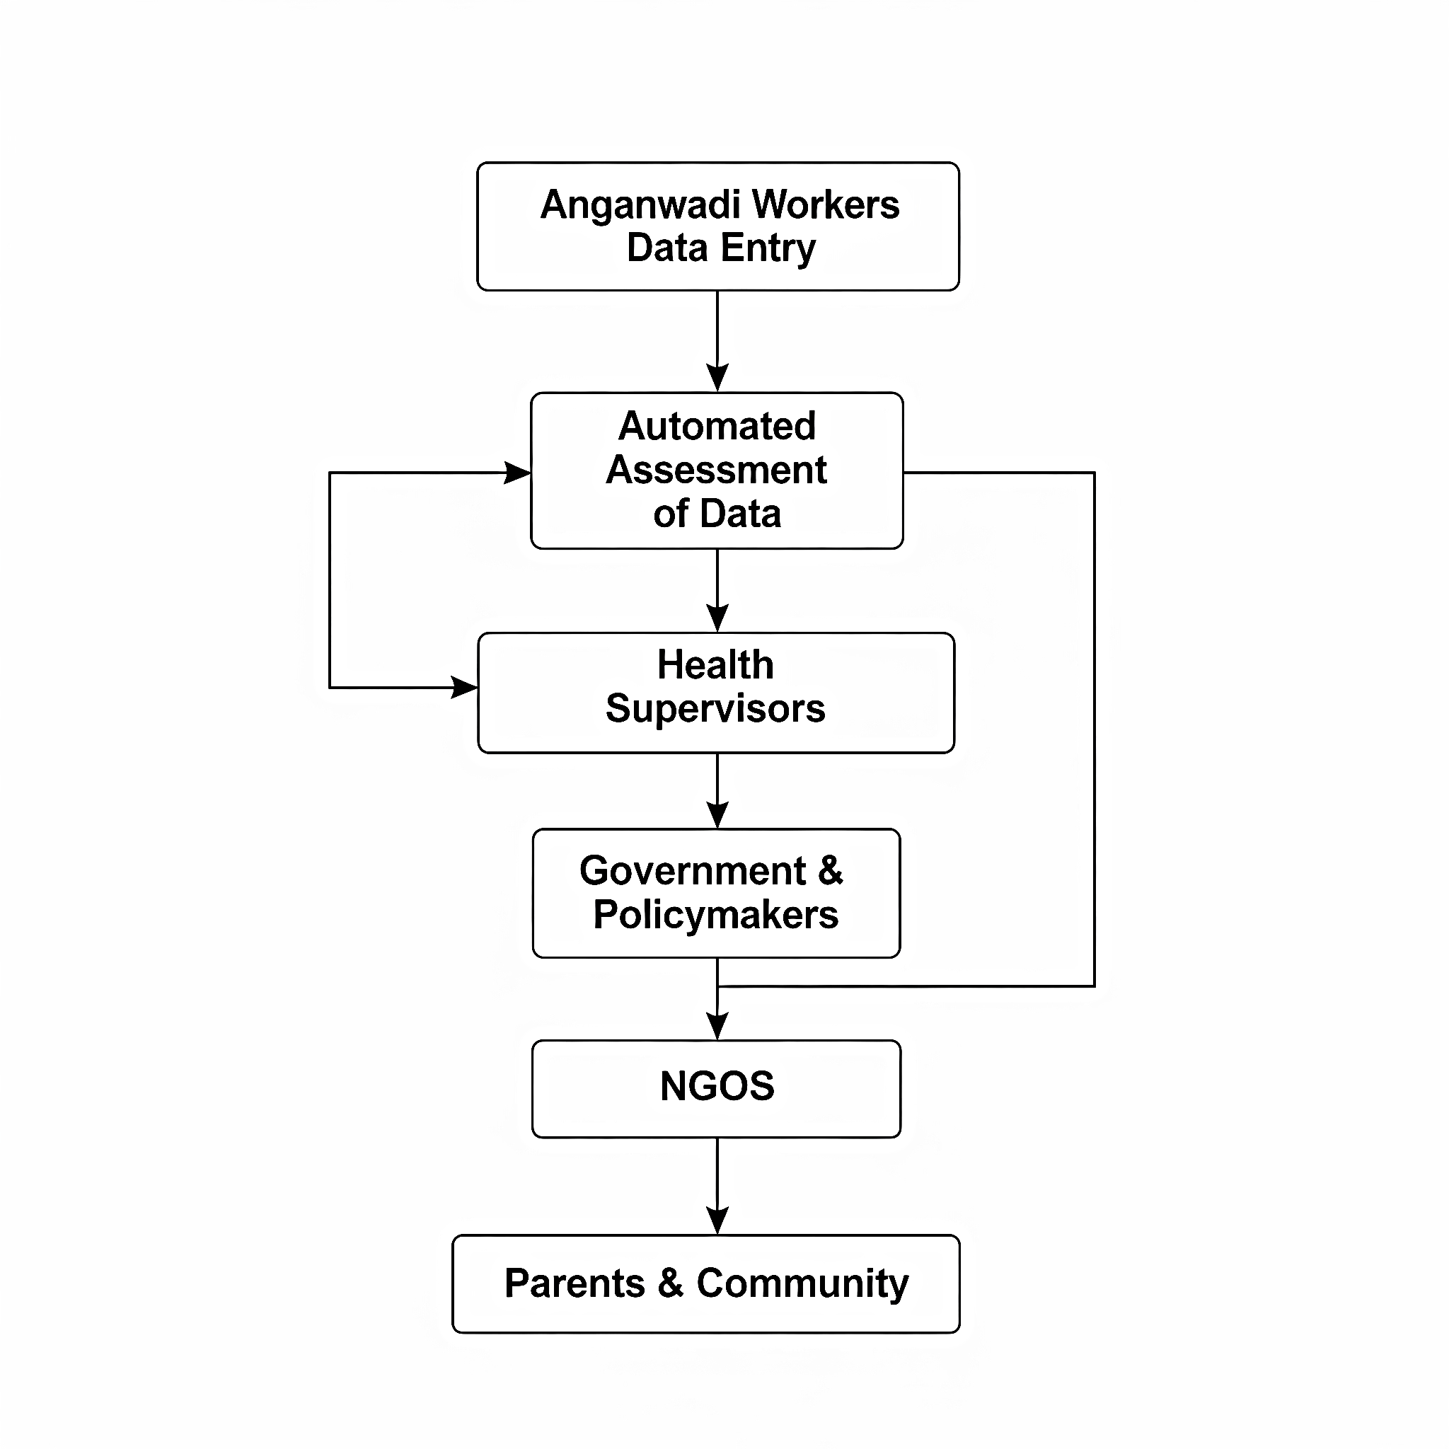
PROPOSED SOLUTION
Our innovative solution streamlines the process from data collection to nutrition kit distribution, ensuring every child receives
the tailored support they need.
Data Entry by AWWs
Automated Assessment
A child visit or scheduled growth monitoring at Anganwadi triggers the data entry process.
Trigger
1
Centralized Reporting
Health
Categorization
Loyalty Loop
4
Continuous centralized reporting and nutrition kit planning create a feedback loop for sustained child health improvement.
Follow-up visits and repeated data entry ensure ongoing tracking, government oversight, and improved planning.
Dynamic Kit
Planning
Active Evaluation
3
2
Automated BMI calculation and WHO guideline comparison actively assess the child’s health.

Slide 4
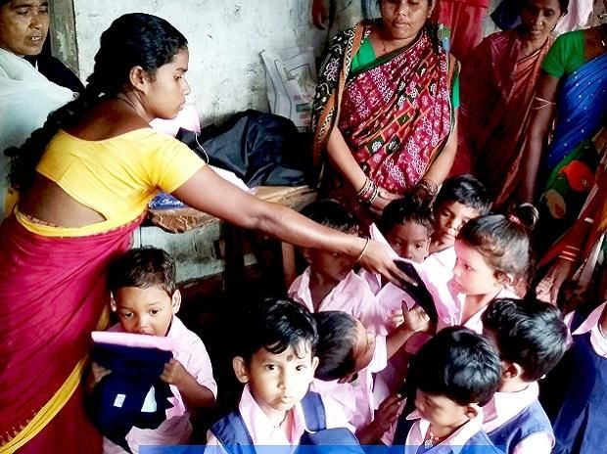
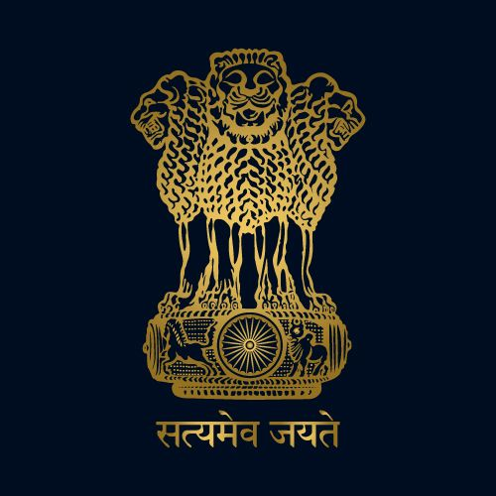
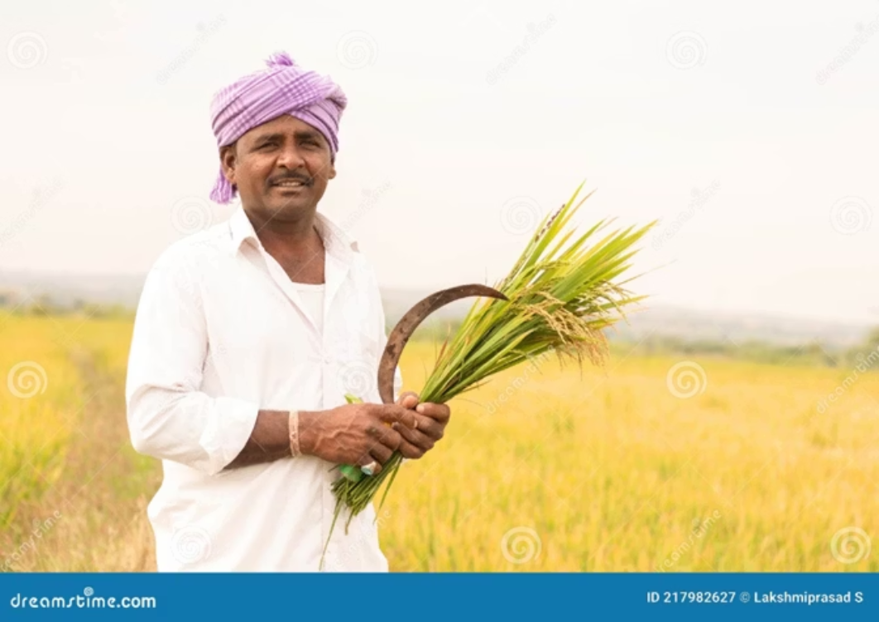
An AI-Powered Nutrition Platform
For Anganwadi Workers
For Government
For Farmers
Easy mobile app interface
(data entry + status tracking)
Centralized dashboard with village-level
data
Local produce gets purchased
for kit creation
Automated BMI & health categorization
Real-time demand for nutrition kits
Economic boost to rural agriculture
Periodic delivery planning

Slide 5
